Slide 1

Premier League rk test
Esteban Jaime, 10/10/22

Slide 2

Problem:
Q. Does higher player spending in the transfer market, lead to better team ranking?

Slide 3

Hypothesis:
Player spending in the transfer market is very important in the past decade, but not nearly as important in the second decade.

Slide 4



Data:
Found online at:
https://fbref.com/en/comps/9/Premier-League-Stats
.
https://www.transfermarkt.us/premier-league/einnahmenausgaben/wettbewerb/GB1

Slide 5

Exploratory analysis:
Imported all data to excel
1st decade (21-12)
2nd decade (11-02).
Organized data into different sheets.
Cleaned data using excel functions:
CountIF, AverageIF, SUMIF, & formulas
Put all the info I needed into my main sheet “Workbook.”

Slide 6
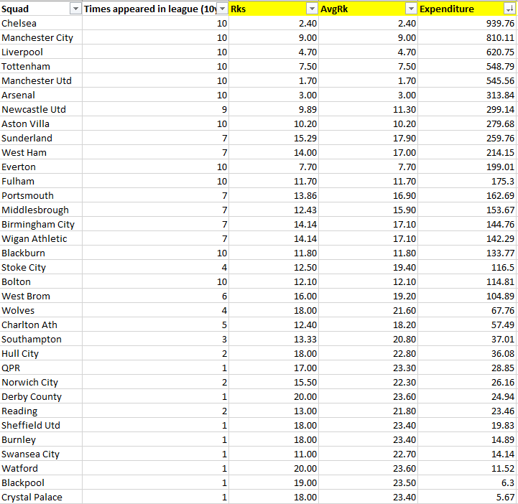
Expenditure:
Total amount a team spent (in Millions) in the Transfer Market.
AvgRk:
Calculated by formula:
[24*(10- Times appeared in league) + (Rks* Times appeared in league]/ 10
24 = additional points given to a team that was not in the premier league.
Avg of top 6 teams in 2nd division/ 6

Slide 7
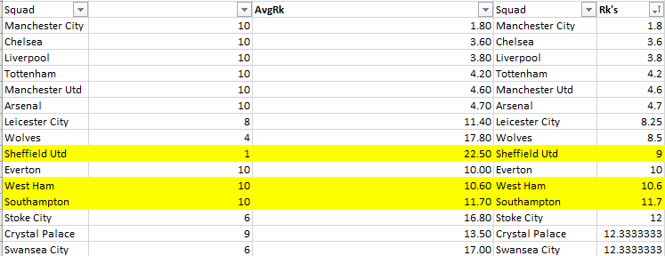
Ex. of problem
The average rank was not correct
Due to it being incorrectly weighed.
Rks - calculated by AVERAGEIF
= Sum of team’s ranks/ # of appearances

Slide 8

Further Analysis:
Used R to:
Create my visualization
Calculator linear regression,
Determine p-value

Slide 9
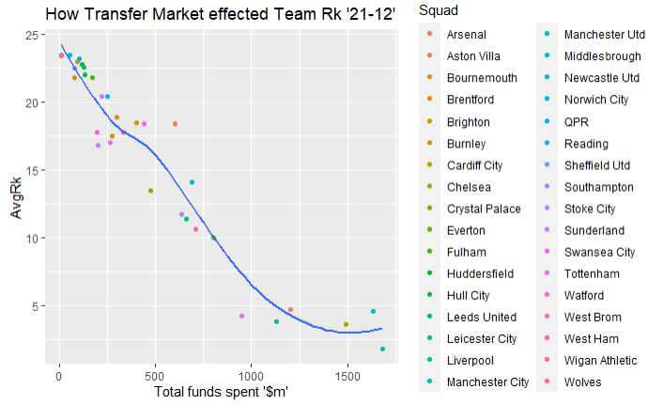
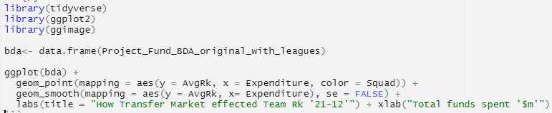
Decade 1
(21-12)
Visualization
X = Exp - (independent Variable)
Y = AvgRk - (dependent variable

Slide 10
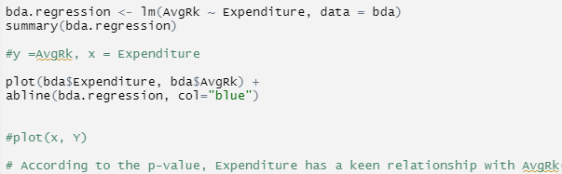
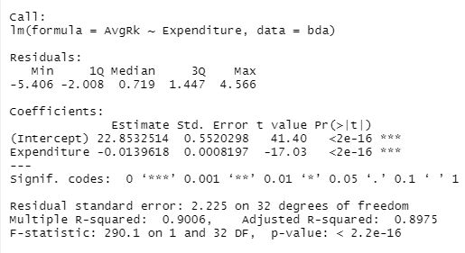
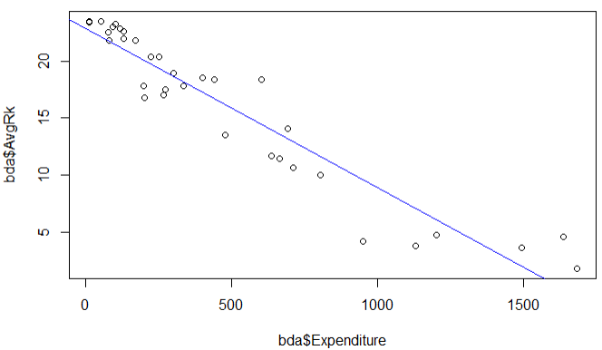
Decade 1 (21-12)
Linear regression/ statistical analysis
P value: 0.00000000000000022
“AvgRk is statistically significant to Expenditure.”

Slide 11
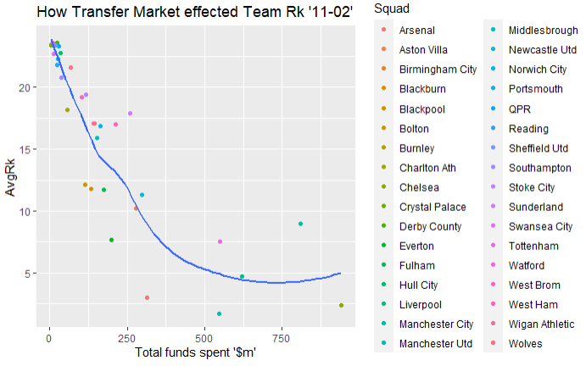
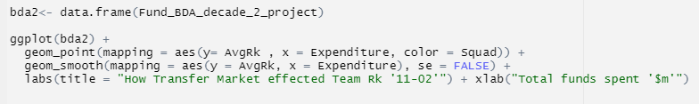
Decade 2
(11-02)
Visualization
X = Exp - (independent Variable)
Y = AvgRk - (dependent variable

Slide 12
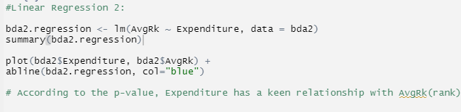
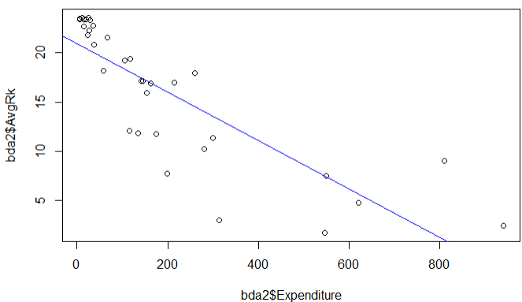
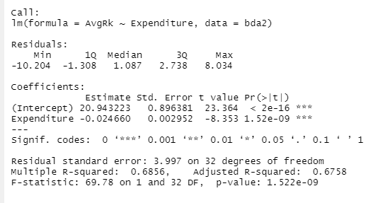
Decade 2 (11-02)
Linear regression/ statistical analysis
P value:
0.000000001522
“Expenditure is statistically significant to AvgRk.”

Slide 13

Conclusion
Hypothesis was correct.

